Slide 1
John 15:1-17 Rod Thom
“ABIDE IN ME”

Slide 2
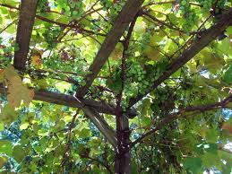
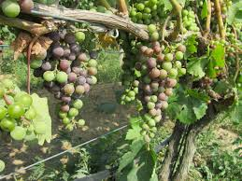
ABIDE IN ME

Slide 3
ABIDE IN ME
John 15:1-3 (MESSAGE)
“I am the Real Vine and my Father is the Farmer. He cuts off every branch of me that doesn’t bear grapes. And every branch that is grape-bearing he prunes back so it will bear even more. You are already pruned back by the message I have spoken.
4 “Live in me. Make your home in me just as I do in you. In the same way that a branch can’t bear grapes by itself but only by being joined to the vine, you can’t bear fruit unless you are joined with me.

Slide 4
ABIDE IN ME
5-8 “I am the Vine, you are the branches. When you’re joined with me and I with you, the relation intimate and organic, the harvest is sure to be abundant. Separated, you can’t produce a thing. Anyone who separates from me is deadwood, gathered up and thrown on the bonfire. But if you make yourselves at home with me and my words are at home in you, you can be sure that whatever you ask will be listened to and acted upon. This is how my Father shows who he is—when you produce grapes, when you mature as my disciples.

Slide 5
ABIDE IN ME
9-10 “I’ve loved you the way my Father has loved me. Make yourselves at home in my love. If you keep my commands, you’ll remain intimately at home in my love. That’s what I’ve done—kept my Father’s commands and made myself at home in his love.

Slide 6
ABIDE IN ME
11-15 “I’ve told you these things for a purpose: that my joy might be your joy, and your joy wholly mature. This is my command: Love one another the way I loved you. This is the very best way to love. Put your life on the line for your friends. You are my friends when you do the things I command you. I’m no longer calling you servants because servants don’t understand what their master is thinking and planning. No, I’ve named you friends because I’ve let you in on everything I’ve heard from the Father.

Slide 7
ABIDE IN ME
16 “You didn’t choose me, remember; I chose you, and put you in the world to bear fruit, fruit that won’t spoil. As fruit bearers, whatever you ask the Father in relation to me, he gives you.
17 “But remember the root command: Love one another.

Slide 8
ABIDE IN ME

Slide 9
ABIDE IN ME
Why do we need to ABIDE in Jesus or make ourselves at home in Him?
V5a NIV “I am the vine; you are the branches. If you remain in me and I in you, you will bear much fruit
If we abide in Christ we
will bear much fruit.
V5b Apart from me you
can do nothing!

Slide 10
ABIDE IN ME
Why do we need to ABIDE in Jesus or make ourselves at home in Him?
b. If we don’t abide in Christ we wither and die
V6 If you do not remain in me, you are like a branch that is thrown away and withers; such branches are picked up, thrown into the fire and burned.

Slide 11
ABIDE IN ME
Why do we need to ABIDE in Jesus or make ourselves at home in Him?
If we abide in Christ our prayers will be powerful and effective
7a If you remain in me and my words remain in you, ask whatever you wish, and it will be done for you. 8 This is to my Father’s glory, that you bear much fruit, showing yourselves to be my disciples.

Slide 12
ABIDE IN ME
2. How do we ABIDE in Christ? How do we remain in His love?
Obedience
9 “As the Father has loved me, so have I loved you. Now remain in my love. 10 If you keep my commands, you will remain in my love, just as I have kept my Father’s commands and remain in his love.

Slide 13
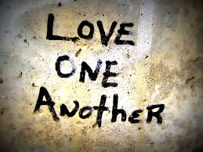
ABIDE IN ME
2. How do we ABIDE in Christ? How do we remain in His love?
b. We ABIDE when we love
one another
12 My command is this: Love each other as I have loved you. 13 Greater love has no one than this: to lay down one’s life for one’s friends.

Slide 14
Communion is a unique time for Christ followers to celebrate and remember Jesus together.
If you love Christ we invite you to join us in partaking of the bread and juice as Jesus commanded us to do.
The bread and juice represent the body and blood of Christ sacrificially given for you. Allow them to speak to you of Christ's love and prayerfully renew your commitment to Live for Him.
We encourage you to thoughtfully and prayerfully eat and drink in memory of Christ in your own time or as the leader may direct.

Slide 16
ABIDE IN ME
2. How do we ABIDE in Christ? How do we remain in His love?
c. We ABIDE when we accept the fact that Jesus has chosen us and appointed us to be fruit bearers and friends

Slide 17
ABIDE IN ME
2. How do we ABIDE in Christ? How do we remain in His love?
V15 I no longer call you servants, because a servant does not know his master’s business. Instead, I have called you friends, for everything that I learned from my Father I have made known to you. 16 You did not choose me, but I chose you and appointed you so that you might go and bear fruit—fruit that will last—and so that whatever you ask in my name the Father will give you. 17 This is my command: Love each other.

Slide 18
ABIDE IN ME

